Slide 1
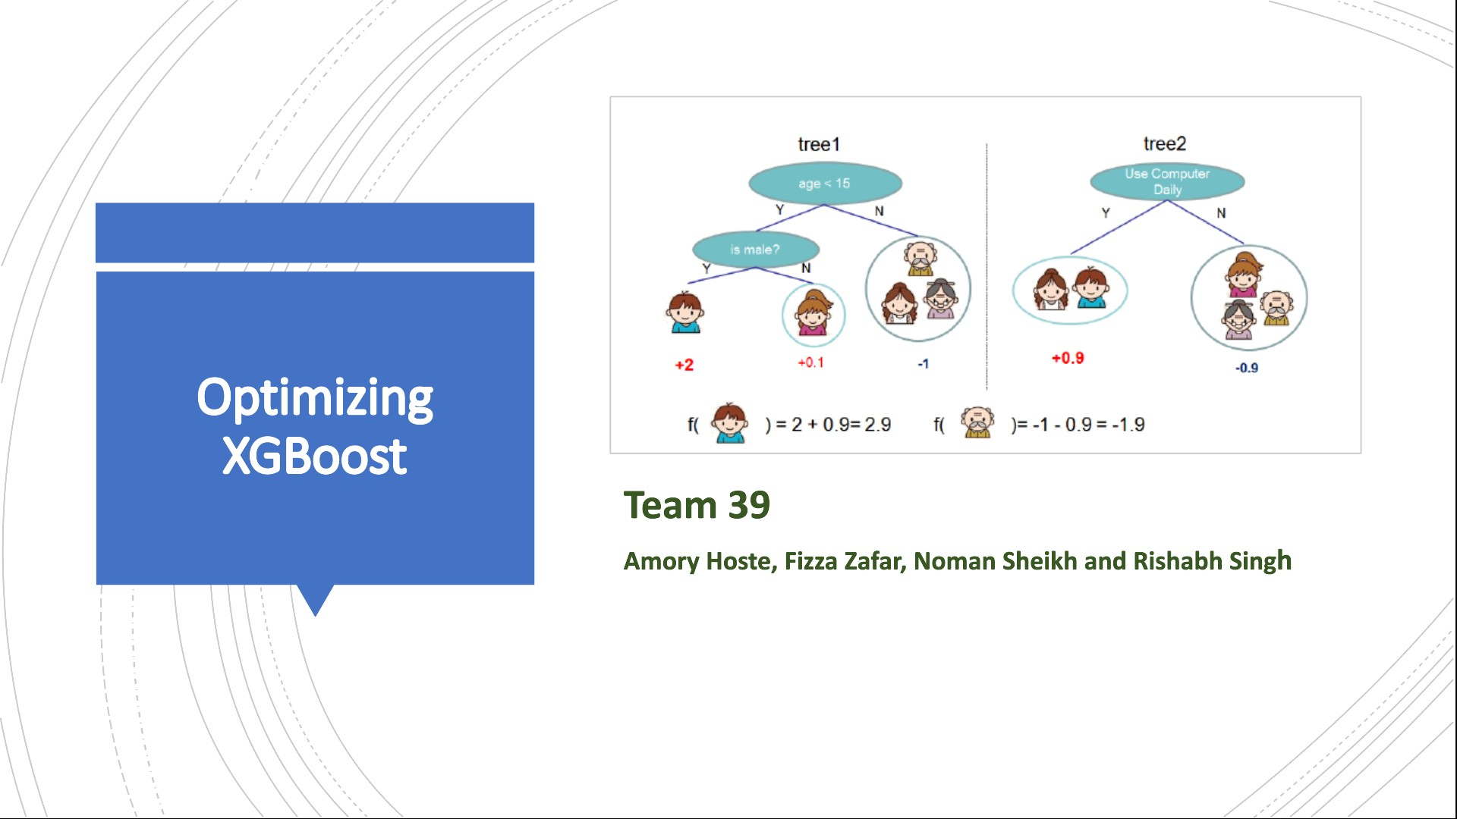
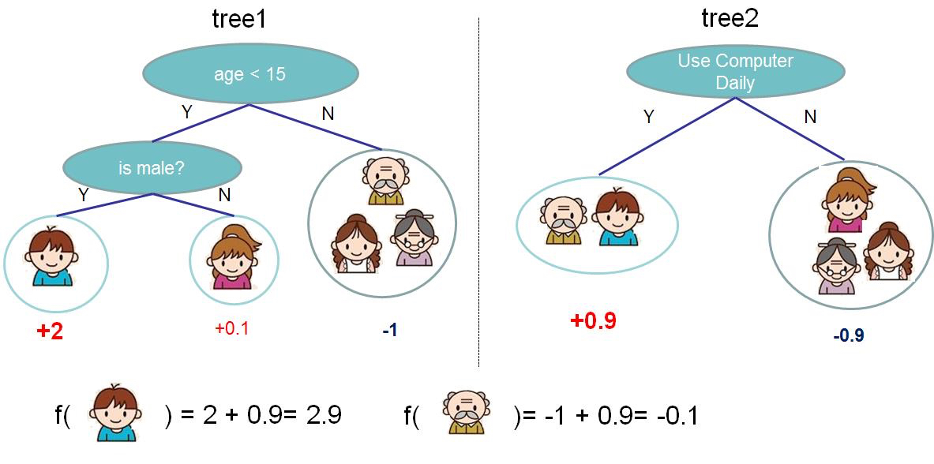

Optimizing
XGBoost
Source: Chen et al, XGBoost: A Scalable Tree Boosting System
Team 39
Amory Hoste, Fizza Zafar, Noman Sheikh and Rishabh Singh

Slide 2
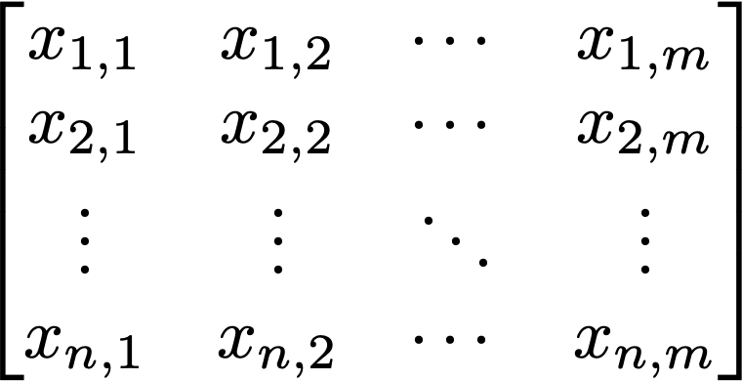




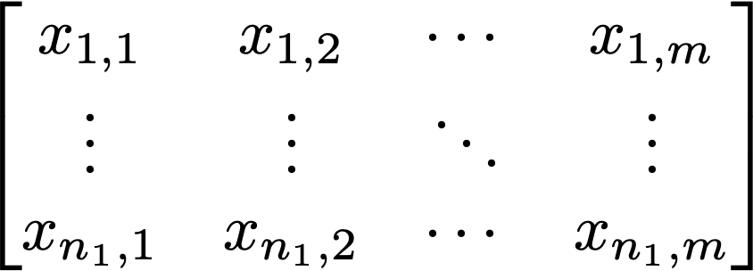


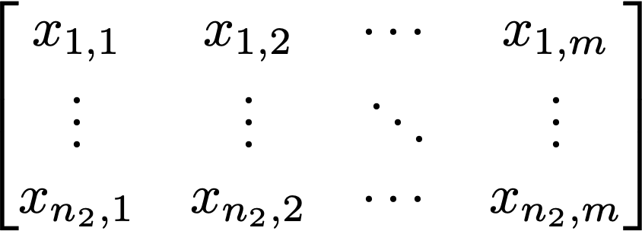
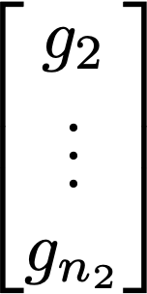

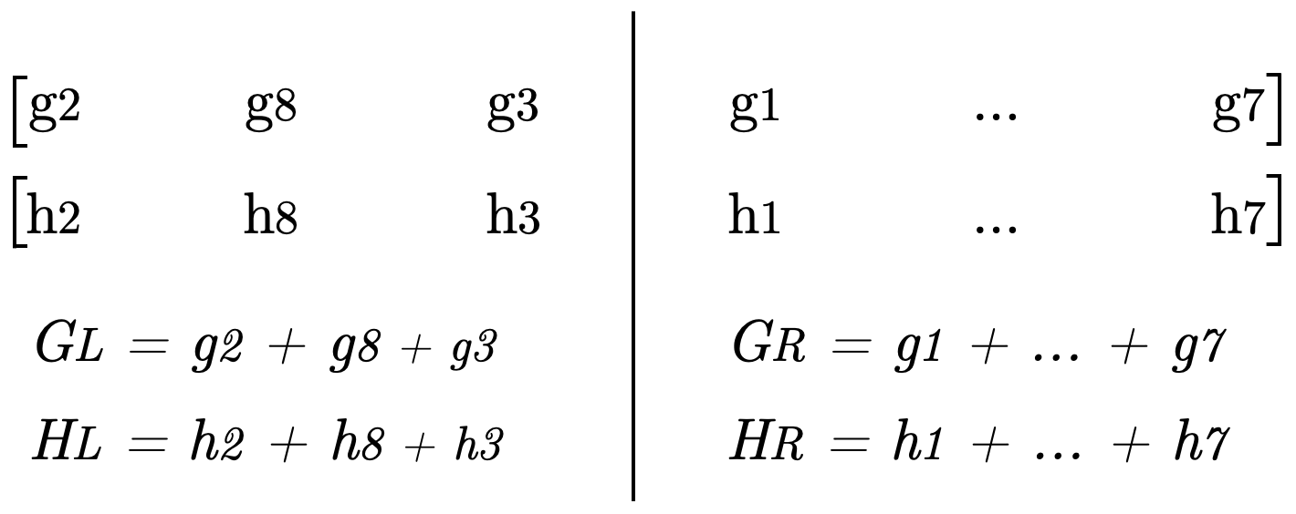
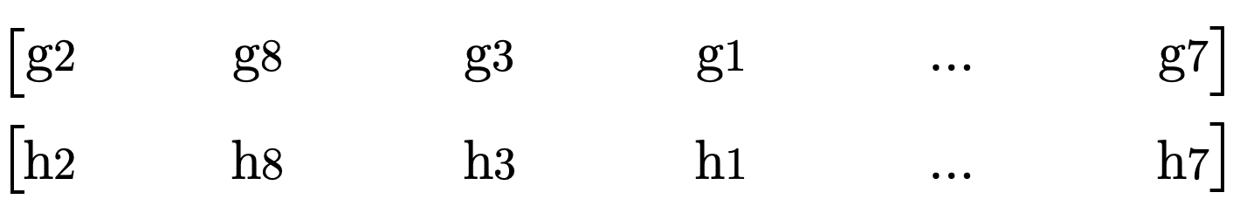

Algorithm Overview
Split finding returns feature 2, value 10
Build trees
Input
xi,2 <= 10
-8.5
xi,4 <= 6.5
xi,2 <= 10
xi,2 > 10
xi,2 <= 45
10.5
...
6
-4
Features
Labels
repeat for all features k ∈ {1..m}
Input
Calculate Gain for
each possible split
Sort Gradients and Hessians on feature k
Features
Gradients Hessians

Slide 3
Overview of Results
4.8x
3.8x
2.1x
SPEEDUP IN
RUNTIME OF
SPLIT-FINDING
(WRT PRESORTING)
IMPROVEMENT IN
PERFORMANCE OF
SPLIT-FINDING
(WRT PRESORTING)
SPEEDUP IN
RUNTIME OF
TREE CREATION
(WRT PRESORTING)
27.1x
44x
6.2x
SPEEDUP
(WRT BASELINE)
IMPROVEMENT
(WRT BASELINE)
SPEEDUP
(WRT BASELINE)

Slide 4
Cost Analysis
Asymptotic Runtime : O(K.d.m.n.logn)
Num of Trees
Depth
Num of Features
Num of Samples
Asymptotic Runtime with Presorting : O(K.d.m.n)
EXACT COST MEASUREMENT
Per call to split-finding (with presorted data)
9.m.n + 2.n
3.m.n
3.m.n
Additions &
Subtractions
Multiplications
Divisions

Slide 5
Optimization Workflow
Column Major Baseline (47.56)
Presorting (2.02)
Eliminate Pointer Chasing (0.62)
Precompute Cumulative Sums (0.419)
Row Major Baseline (54.66)
Row Major Presorting
Blocked Data (0.404)
Blocking with SIMD
Row Major SIMD (1.49)
Using Quicksort (0.409)
Using Mergesort (0.410)

Slide 6

Core: Intel(R) Core (TM) i5-8257U CPU @ 1.40 GHz (Coffee Lake)
L1: 32 KB
L2: 256 KB
L3: 6 MB
Operating System: macOS Catalina (10.15.3)
Compiler: gcc 4.2.1 (linked to clang 11.0.0)
-03
-fno-tree-vectorize
-march=native
Dataset: Criteo Terabyte Click Log Dataset
7,218,569 samples
10 features
Experimental
Setup

Slide 7
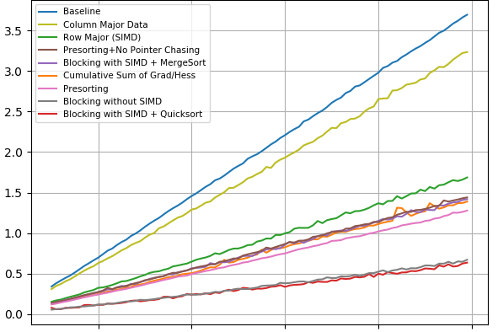
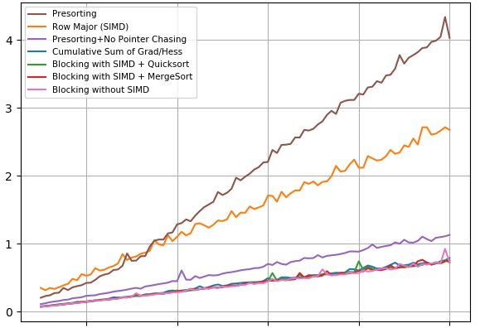
Runtime
Run time [cycles 1e10]
Complete Tree
Run time [cycles 1e8]
Split Finding Algorithm
200k 400k 600k 800k 1000k
200k 400k 600k 800k 1000k
Number of rows
Number of rows

Slide 8
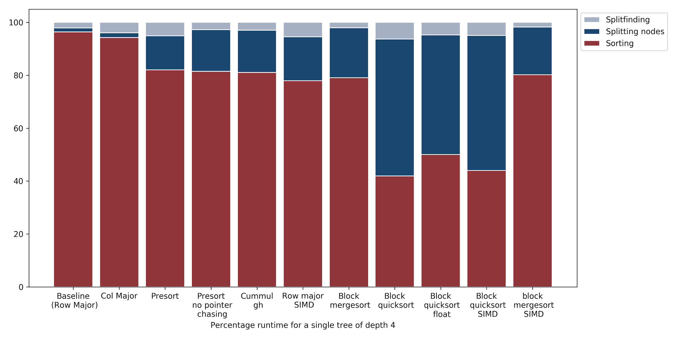
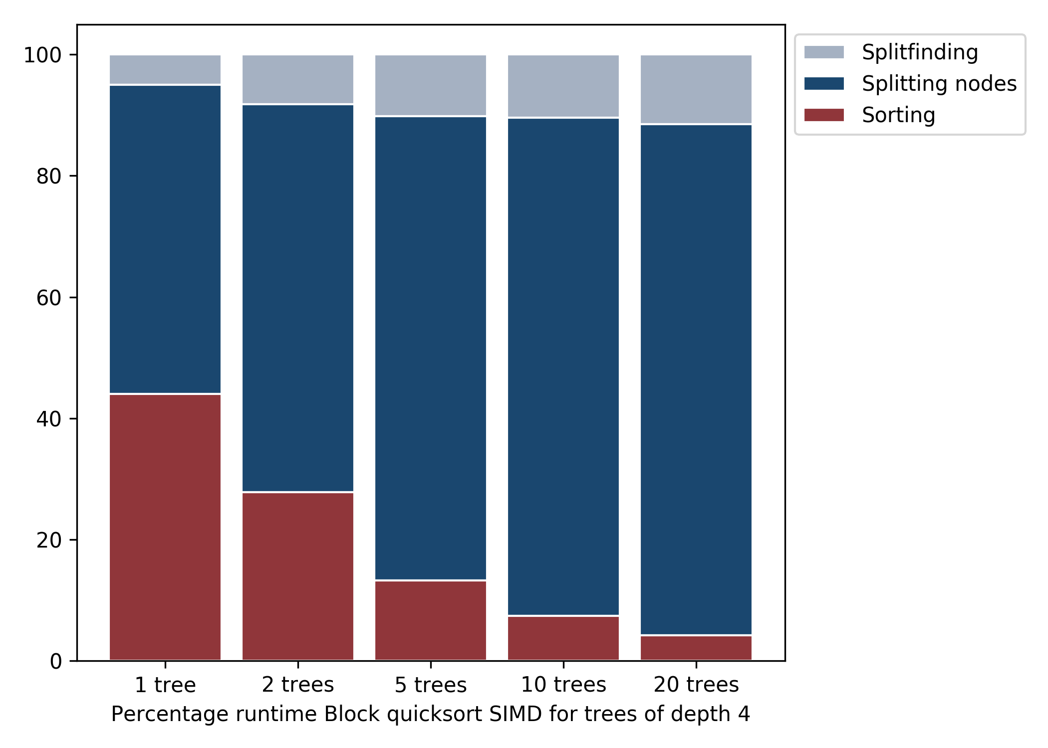
Percentage of Total Runtime¹
¹Blocking with SIMD and Quicksort

Slide 9
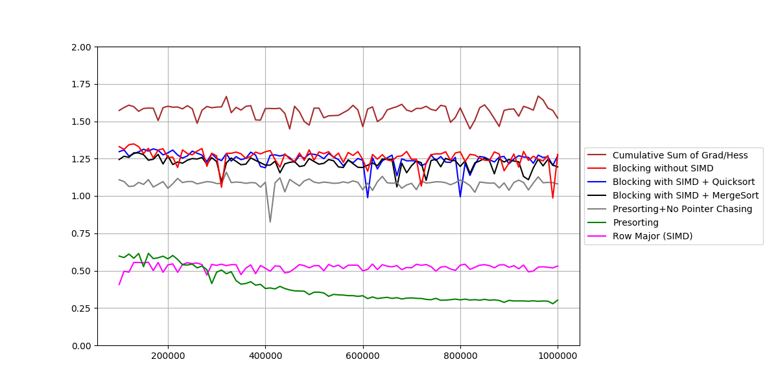
Performance of Split Finding Algorithm
Performance [flops/cycle]
200k 400k 600k 800k 1000k
Number of rows

Slide 10
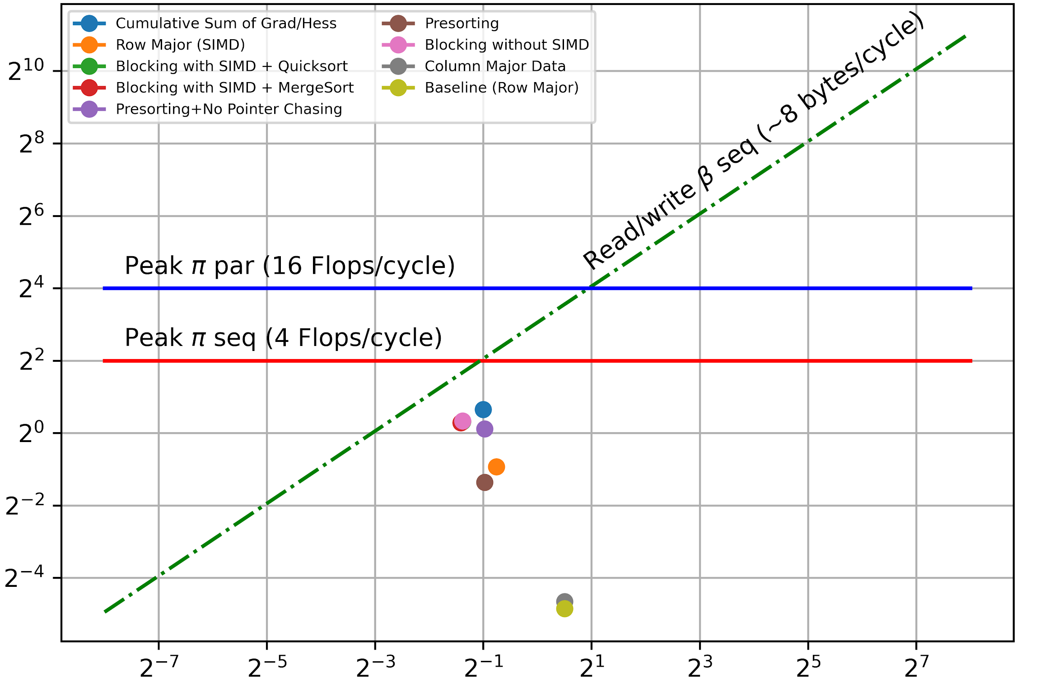
Roofline Plot
P(n) [flops/cycle]
I(n) [flops/byte]

Slide 11


